Slide 1
JOB PORTAL
Presented by:
Harendra Kumar
UID: 21MCI1041

Slide 2

Index
Introduction
Who can use this ?
Features
User Interface
Technology Used
Objective
Future Scopes

Slide 3
Introduction
It is a platform mainly for job seekers and employers
Provides online information about recruiters as well as job seekers
Help employers in finding suitable candidates for their open position
Help job seekers in finding and applying for the interested jobs

Slide 4



Who can use this?
Job Seekers : Anyone who is looking for a job can use this to search and apply for relevant job openings.
Recruiters : Companies and organizations of all sizes can use this to post job openings and manage their hiring process
Admin : Admins can use this job portal to manage and monitor the entire system

Slide 5
Features
For Job Seekers
Authentication
Manage their profiles
View Jobs and Jobs Details
Apply for the jobs by just one click
Upload their resume
For Recruiters
Authentication
Manage their profile
Post Jobs
View and manage posted jobs
View Applicants

Slide 6
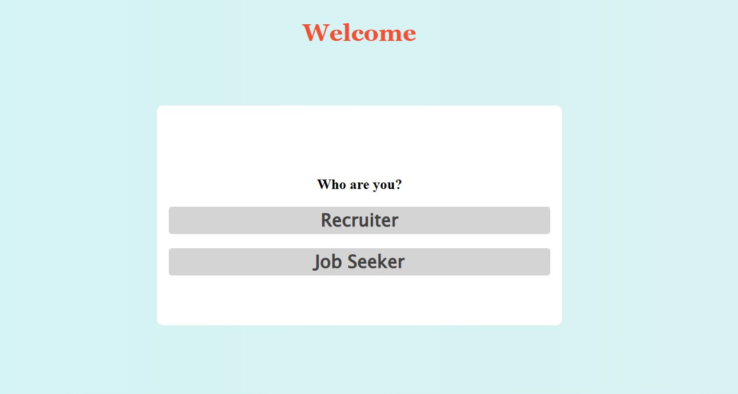
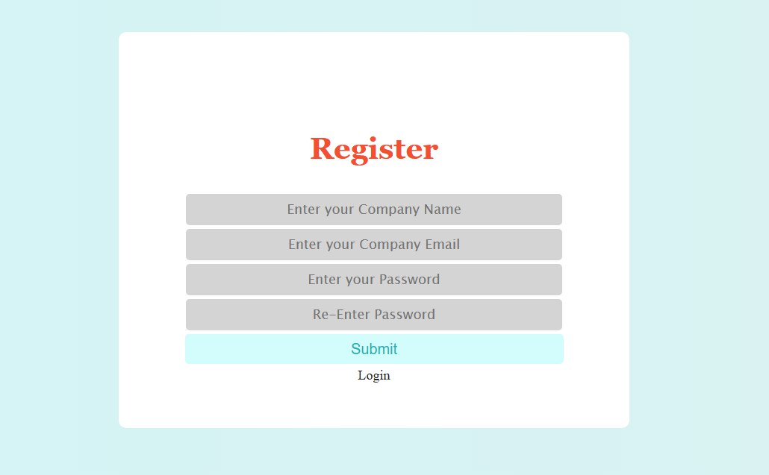
User Interface
Home Page
Recruiter Signup Page

Slide 7
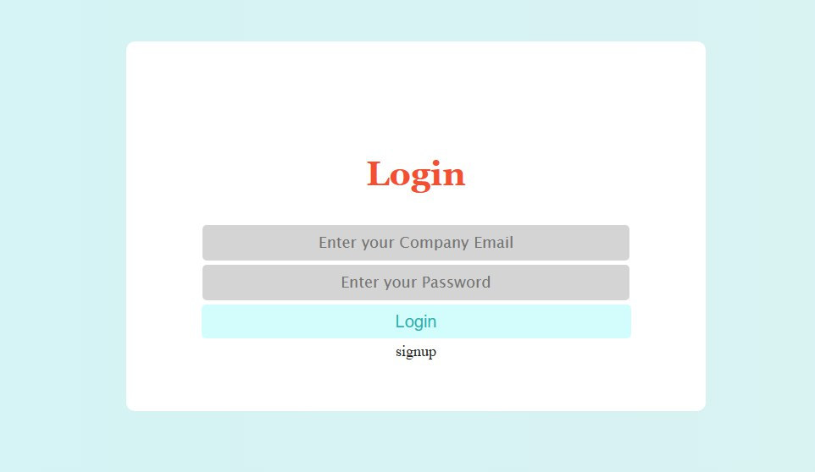
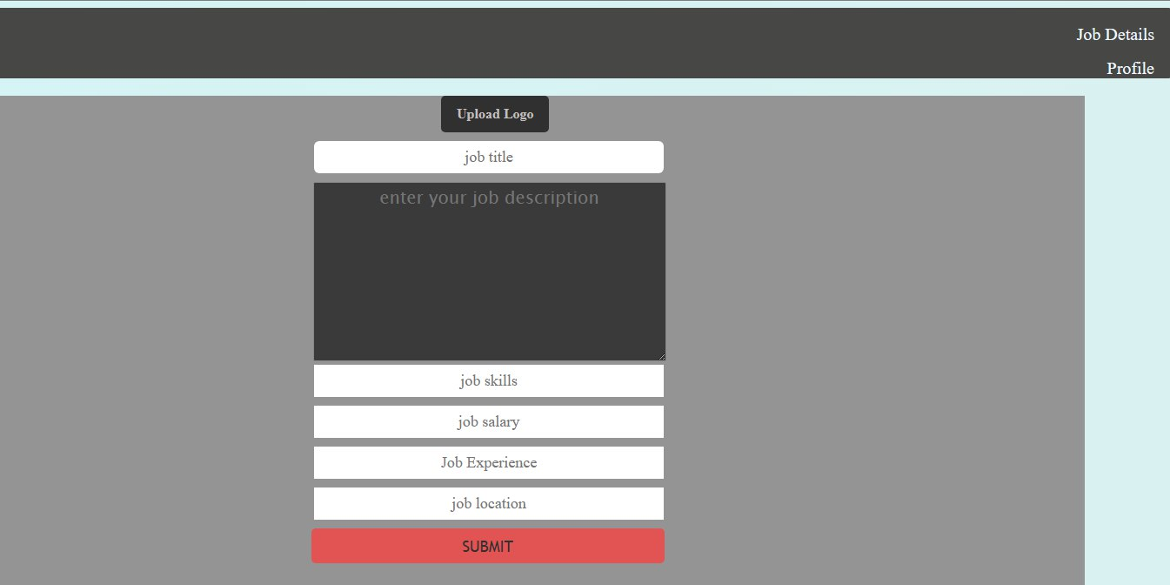
User Interface
Recruiter Login Page
Job Posting Form

Slide 8
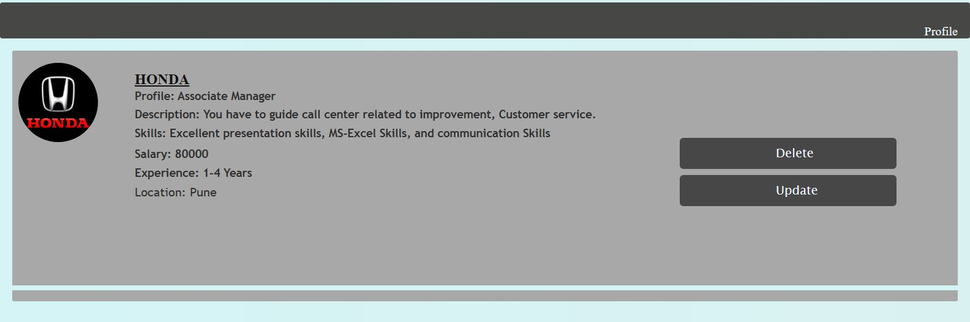
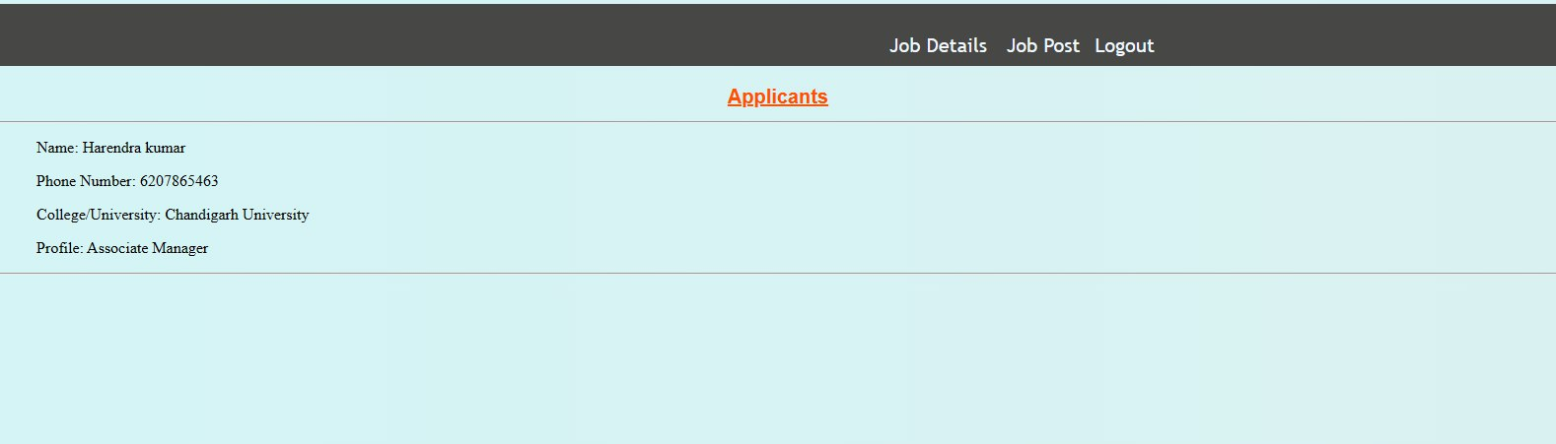
User Interface
Job Details
All Applicants List

Slide 9
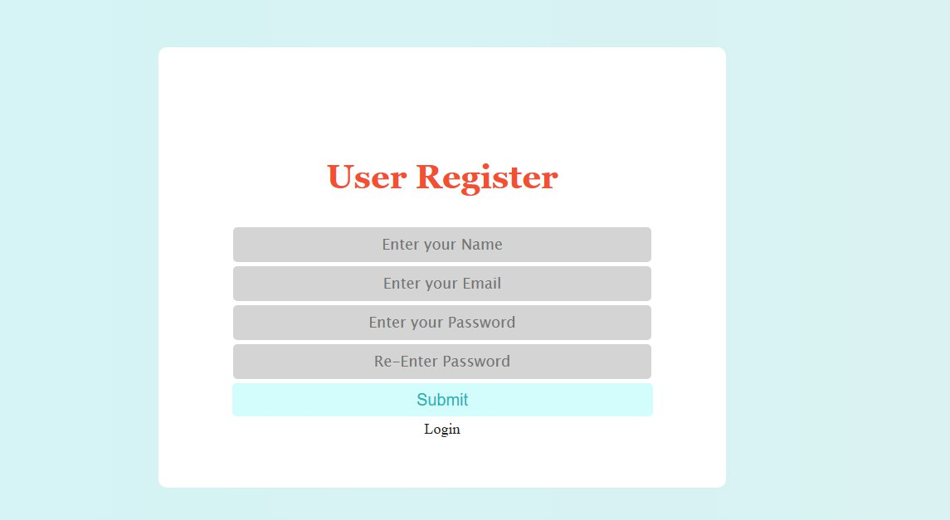
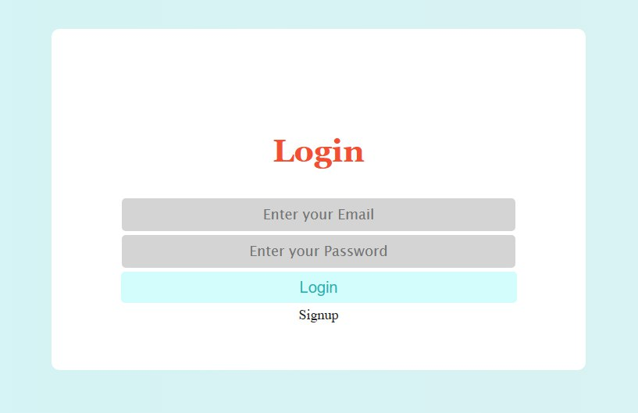
User Interface
Job Seeker Signup Page
Job Seeker Login Page

Slide 10
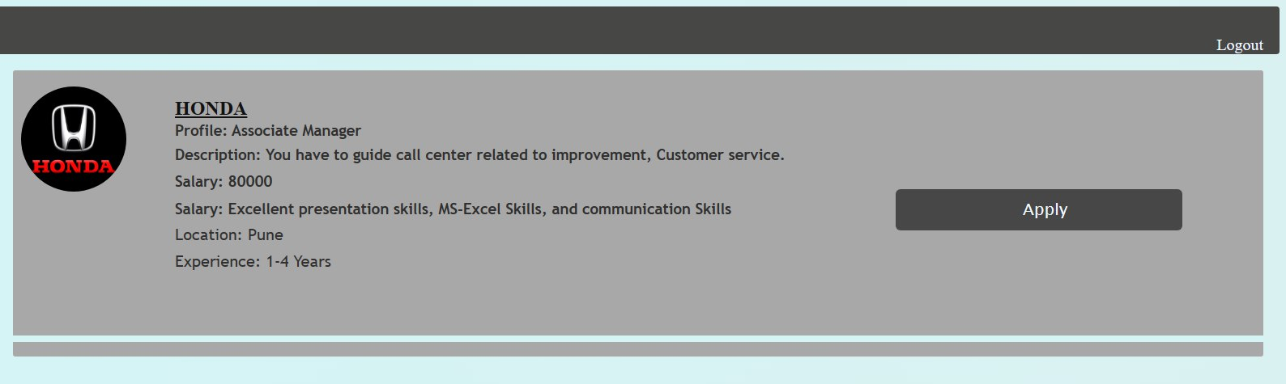
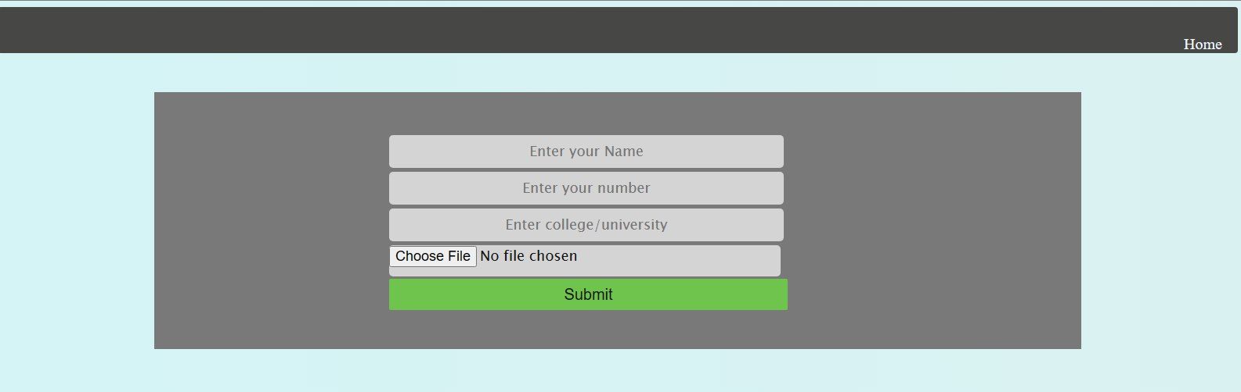
User Interface
Jobs List
Application Form

Slide 11




Technology Used
Programming Language:
Python
Framework:
Django
Web Technologies:
HTML
CSS
Editor:
Visual Studio Code

Slide 12
Objective
Provide a user-friendly platform that connects job seekers and employers
To provide a very easy user interface
To reduce the time and effort by allowing job seekers to upload resumes and apply for jobs with just few clicks
To provide employers with tools to manage job postings

Slide 13
Future Scope
Advanced Search Functionality: User can search jobs with by position, location, salary, experience level
Personalized Job Recommendations: Users could be provided with tailored job recommendations based on their skills, experience, and interests
Resume Parser: It allows job seekers to upload their resumes and automatically fills in the application fields
Feedback and rating system: Job seekers can rate the employers and vice versa based on their experience.
Mobile Application: To engage more users with all the functionality of desktop version

Slide 14


